Slide 1

Welcome to our project
JAMMU SUNITHA
MURRI JAHNAVI

Slide 2
Name of the project
Credit card fraud detection

Slide 3
Contents
Introduction
Problem statement
Fraud detection
Fraud detection process
Technologies used
Modules
Dataset for credit card fraud detection
Data flow diagram
Advantage
System Requrements
Conclusion and future scope

Slide 4
Modules
Module 1: Frame the problem
Module2: Collect the raw data,download data from kaggle
Module 3: import the libraries,pandas,numpy,sklearn .
Module 4:Process the data for analysis
Perform the Random Forest algorithm,Logistic Regression,Decision Tree classifier on the data
Explore the data
Module 5: Perform the in-depth analysis
Module 6:Communicate results of the analysis

Slide 5
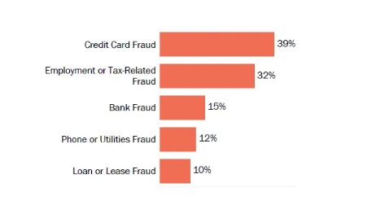
INTRODUCTION
The online shopping growing day by day.credits are used for purchasing goods and service with the help of virtual card and physical card offline.

Slide 6
In credit card based purchase,the card holder issues his card to merchant to do payment.
The person has to steal the card to make the transaction fradulent.
If the user is not aware of loss of card it leads to financial loss to the user as well as credit card company...

Slide 7
Problem statement
The credit card fraud detection problem includes modelling the past credit card transactions with knowledge of the ones that turned out to be fraud.
This model is then used to identify whether a new transaction is fraudulent or not.
Our aim here is to detect 100% of the fraudelent transactions while minimizing the incorrect fraudulent classifications

Slide 8
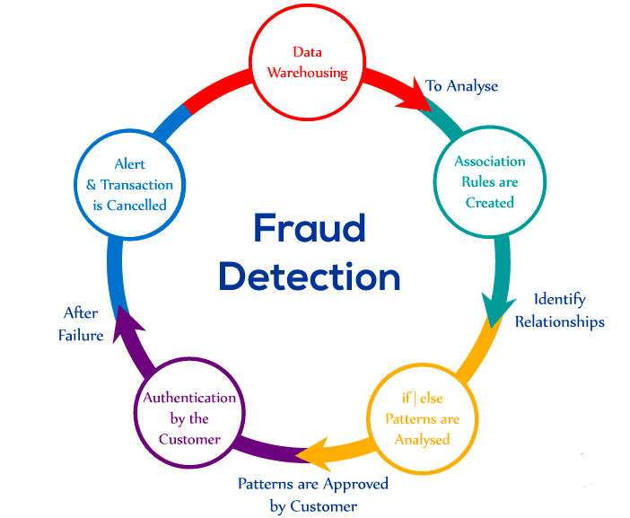
Fraud Detection Process

Slide 9
Methodology
The major aspect of this project to develop a best-suited algorithm to
find the outliers or frauds in the case of credit cards. We will
implement three of several machine learning algortithms
We will implement algorithms like:
1.RANDOM FOREST
2.DECISION TREE
3.LINEAR REGRESSION
1) Data Processing:
• Libraries Used for Data Preprocessing: Pandas, NumPy
• Operations applied: Featuring Scaling, PCA
• Columns Dropped: Time

Slide 10
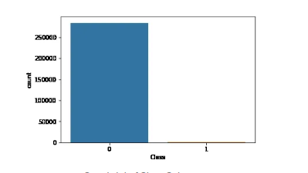
2) Visualization:
Libraries Used for Visualization: Matplotlib
Histogram Plot of Class Columns

Slide 11

Technologies Used
Common credit card fraud techniques
Credit card fraud rose by a whopping 46% in 2021 when digital transactions became the norm.
The US has been a significant contributor to this statistic. This means that the modi operandi of
credit card fraudsters have also witnessed change. The various ways in which fraudsters can
commit credit card fraud include:
Creating counterfeit credit cards using legitimate credit card information
Creating and using new credit card accounts under someone else's name
Stealing an existing credit card holder's account

Slide 12
Benefits of using ML
Machine learning (ML) models are much better than conventional fraud detection models.
They can recognise thousands of patterns from large datasets. ML offers an insight into how
users behave by understanding their app usage, payments, and transaction methods.
Some of the benefits of fraud detection using ML are as follows:
Faster detection:
A machine learning model can quickly identify any drifts from regular transactions and user
behaviours in real time. By recognising anomalies, such as a sudden increase in transactional
amount or location change, ML algorithms can minimise the risk of fraud and ensure more
secure transactions.

Slide 13
Higher accuracy:
Conventional fraud detection techniques cause errors at the payment gateways that sometimes
result in genuine customers being blocked. With sufficient training data and insights,
ML models can achieve higher accuracy and precision, reducing these errors along with the time
required to be spent on performing manual analysis.
Improved efficiency with larger data
Once an algorithm picks up different transactional patterns and behaviours, it can efficiently work
with large datasets to separate authentic payments from fraudulent ones. The models can
analyse huge amounts of data in seconds while offering real-time insights for improved
decision-making capabilities.

Slide 14
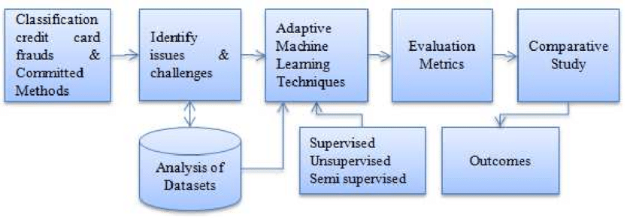
Data flow diagram

Slide 15
Dataset for credit card fraud detection

Slide 16
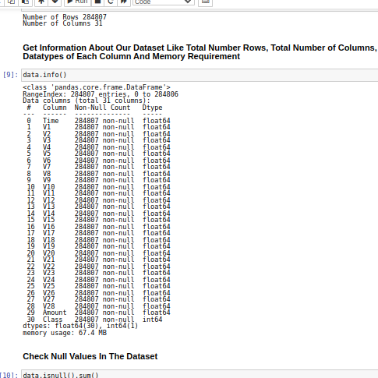
Dataset for credit card fraud detection

Slide 17
The dataset that is used for credit card fraud detection is derived from the kaggle
Kaggle is the online community of data scientist and machine learners
Kaggle allows the users to find and publish data sets,
Explore and build models in a web-based
Data science project and solve challneges..

Slide 18
System Requirements
Hardware requirement:
RAM:4GB and higher
Processor:Intel i3 and above
Hard Disk:500GB:Minimum
Software Requrement
OS:Linux
Python IDE:python 2.7.x and above
Jupyter notebook
Setup tools and pip to be installed for 3.6 and above
Language:Python

Slide 19
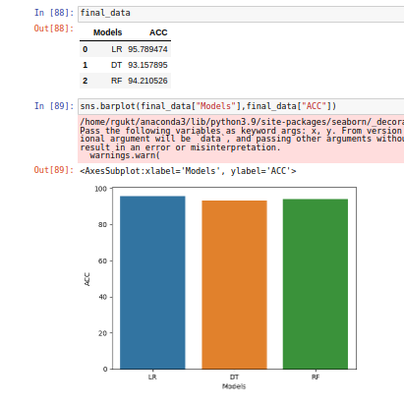
Result

Slide 20
Conclusion and Future Scope
Fraud detection system have become essential for banks and finanacial institution,to minimize their losses
However ,there is a lack of published literature on credit card fraud detection techniques,due to the unavailable credit card transanction dataset for researches

Slide 21
We desingned a system to detect fraud in credit card transanction.This system is capable of providing most of the essential features require to detect fradulent and legitimate transactions.
The dataset is available on day to day processing may become outdated,it is necessary to have update data for effective fraud behaviour indentification..

